Slide 1
Design & Analysis
of Algorithms
Lecture # 1
AHSAN HUMAYUN
ahsanhumayun.ah@gmail.com

Slide 2
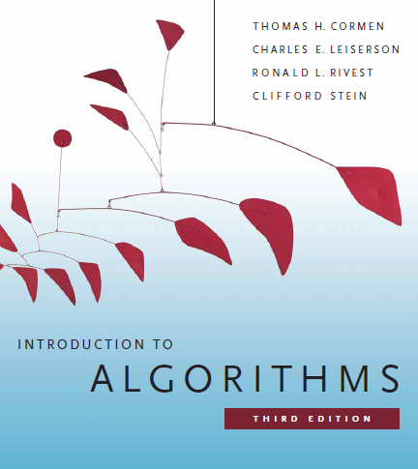
Text Book
“Introduction to Algorithms”,
By Thomas H. Cormen

Slide 3
Assessment & Evaluation Cr-Hrs(3-0)
Activities | Percentage(%)
Quizzes | 10
Assignments | 15
1st Sessional | 10
2nd Sessional | 15
Terminal | 50

Slide 4
Reference Material Link
“All the reference material will be available at the link:”,
https://ahsanhumayun.wixsite.com/ahsan

Slide 5
Importance of studying this subject
Gives mathematical foundations for analyzing algorithms
Lot of candidate solutions
Learn good designing techniques
Part and parcel of computer science and computer programming.
Example: Google’s PageRank Technology

Slide 6
Design and Analysis of Algorithms
Analysis: predict the cost of an algorithm in terms of resources and performance
Design: design algorithms which minimize the cost

Slide 7
Today’s Agenda
Definition
History
Efficiency of algorithm

Slide 8
Definition of Algorithm
Any computing problem can be solved by executing a series of actions in a specific order, that is called algorithm
Algorithm is a well-defined computational function or procedure that take some value or set of values as an input and produces some value or set of value as an output

Slide 9
Algorithms
Algorithm is a function or procedure
Which takes an input and produces some output
Input(n)
f(n)
Output (n`)

Slide 10
Algorithm Writing..
It should be language independent
Algorithm can be written in any manner unless they provide the solution of a problem
Two styles are normally used
Pseudo-code
Flow Chart

Slide 11
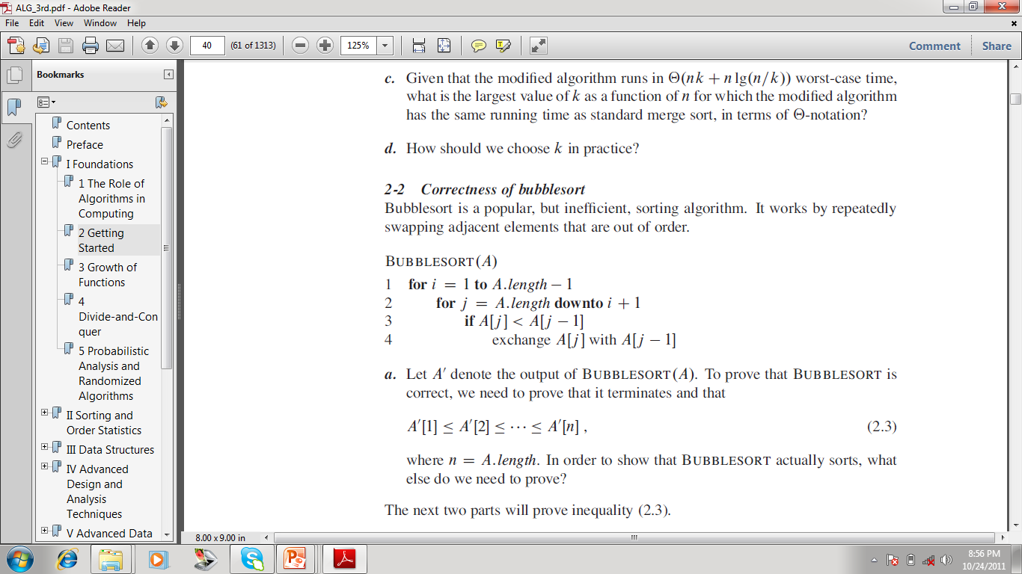
Algorithms (Pseudo-code)

Slide 12
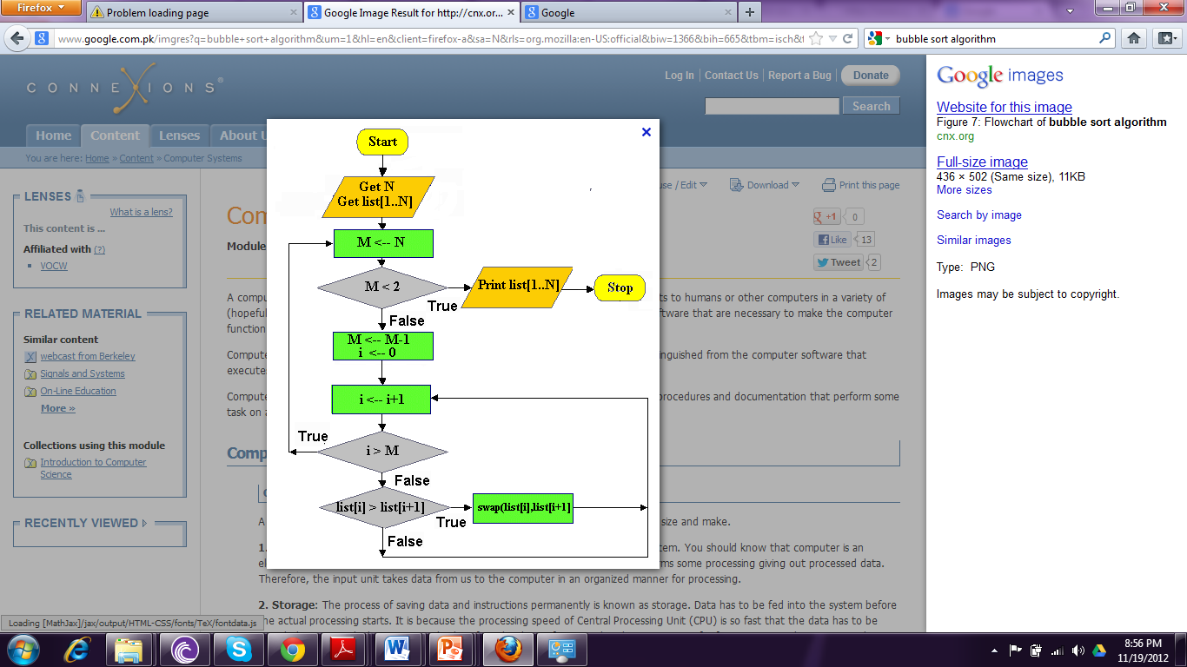
Algorithms (Flowchart)

Slide 13
Algorithms (c++ Code)
void bubbleSort(int Size, number[]){
for(int i=0;i<Size-1;i++){
for(int j=0;j<Size-1;j++){
if(number[j]<number[j+1]){
int temp=number[j];
number[j]=number[j+1];
number[j+1]=temp;
}
}
}

Slide 14
Algorithms (Pseudo-code)

Slide 15
Algorithm History
First used by Abu Ja’far Muhammed Ibn Musa al-Khowarizmi (780-850)
Member “house of wisdom” in Baghdad
Original word “algorism”
This word evolved into the word of Algorithm in eighteen century

Slide 16
Algorithm History
His book “Hindu Numerals” is basis of modern decimal notation
He give the concept of “zero”
Western Europe first learned Algebra from him
Algebra comes from al-jabr, part of title of his book kitab al-jabr w’al muquabala

Slide 17
Introduction To The Course
Basic concepts
Algorithm definition and importance in CS
Analyzing Algorithm, Algorithm designing
Growth of function Asymptotic Notation
Recurrence and Mathematical Induction: The substitution method, Recursion Tree Method, The Master Method
Sorting
Heapsort: Heap sort, maintaining a heap property, Building a heap, the heap sort algorithm.
Quicksort: Description of Quick sort, Performance of Quick sort.
Sorting in linear time: Lower bound for sorting, Counting sort, Radix sort, Bucket sort.
Advance Design Techniques
Dynamic Programming: Dynamic Programming, Matrix Chain Multiplication, Knapsack Problem.
Greedy Algorithm: Elements of Greedy Algorithm, Huffman Code

Slide 18
Introduction To The Course
Graph Algorithms
Elementary Graph Algorithm: Some concepts about Graphs, Representation of graphs, Breath First Search, Depth First Search, Topological sort.
Minimum Spanning Tree: Krushkal Algorithm, Prims Algorithm.
Single Source shortest Paths: Bellman Ford Algorithm, Single Source Shortest paths in direct acyclic graph, Dijkstra’s Algorithm.
All Pairs shortest Paths: Floyd Warshall Algorithm
NP-Complete Problems
Polynomial time
Polynomial time verification
NP-completeness and reducibility

Slide 19
How fast will your program run?
The running time of your program will depend upon:
The algorithm
The input
Your implementation of the algorithm in a programming language
The compiler you use
The OS on your computer
Your computer hardware
Maybe other things: temperature outside; other programs on your computer; …
Our Motivation: analyze the running time of an algorithm

Slide 20
Criterion for analyzing
We will measure algorithm in terms of the amount of computation recourses that algorithm requires:
Running time
Memory used
We should be agree on some criterion

